Slide 1
Vali IT
Transaction

Slide 2
Transaction
Database transaction is a unit of work that you want to treat as a whole.
Transaction either executes fully or doesn’t execute at all

Slide 3
Transaction sample
Car.reg_num
123ABC
124ABC
125ABC

Slide 4
Transaction sample
BEGIN TRANSACTION;
DELETE FROM car;
SELECT * FROM car;
Car.reg_num

Slide 5
Transaction sample
Car.reg_num
123ABC
124ABC
125ABC
BEGIN TRANSACTION;
DELETE FROM car;
SELECT * FROM car;
ROLLBACK
-- COMMIT
SELECT * FROM car;

Slide 6
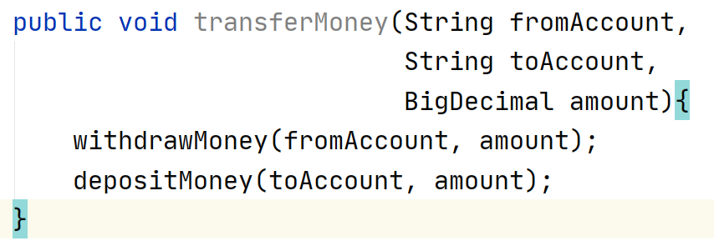
BankController

Slide 7
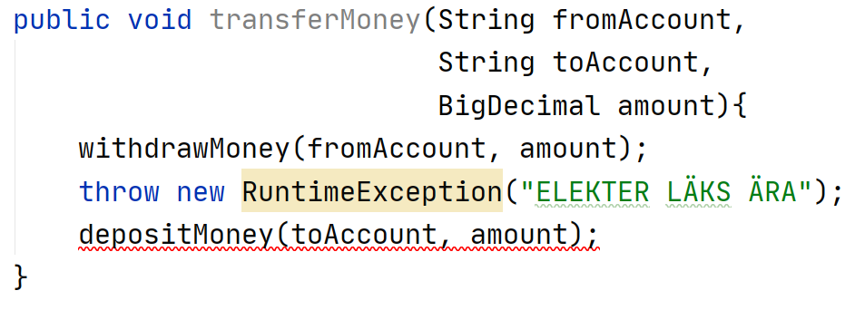
BankController problem

Slide 8
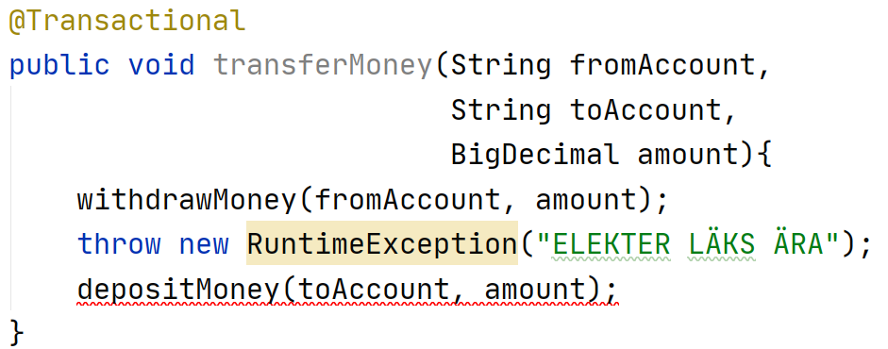
BankController solution

Slide 9
@Transactional (where to use)
Use it on service layer methods
Transactional annotation can be used on classes
It might be a good idea to use @Transactional on all service methods (Especially if you are using Hibernate)
You can use @Transactional(readOnly = true), to mark transaction as read only

